Slide 1
Unlocking Insights: Optimizing Your Text Data with Machine Learning
May 31, 2024
Xiaoxia Zhang, higher education doctoral student
Yih Tsao, higher education doctoral student
Brendan Dugan, Research Associate, NSSE, Indiana University
INDIANA UNIVERSITY

Slide 2

Overview
Introduction: The Needs of ML Techniques in Text Data Analysis
Context of Case Studies: NSSE Topical Modules
First-Year Experiences & Senior Transitions
Coping with Covid
Data Analysis & Visualization of Case Studies
Text Data Analysis Process and Techniques
Conclusions & Implications
Demonstration and Steps to Create Your Own
R code and Packages
Workflow (steps)
Discussion & Questions

Slide 3
The Needs of ML Techniques in Text Data Analysis
Text data analysis (Nawaz et al., 2022)
Rich Detail: Extensive information, including nuances, context, and specifics that may not be captured in numerical or structured data formats.
Actionable Insights: To make informed decisions, develop strategies, and improve processes based on the findings extracted from textual sources.
Overall Challenges of analyzing text data (Ittoo et al., 2016, Nawaz et al., 2022)
Scale and Scope Limitations
Bias and Inconsistency
Thematic analysis of large text data (Braun & Clarke, 2023)
Handling extensive textual data
Dealing with thematic diversity
Distinguishing between topic summaries and thematic codes

Slide 4
The Needs of ML Techniques in Text Data Analysis
Context
Machine Learning techniques: Natural Language Processing (NLP) (Roberts et al., 2014)
Efficient Information Extraction: NLP efficiently identifies patterns, sentiments, and key themes from open-ended responses to uncover actionable insights and make informed decisions.
Time and Cost Reduction: NLP significantly reduces the time and cost of manual analysis processes by automating the text analysis.
Advanced Analysis for Large Datasets: One of the techniques for analyzing themes and patterns from large student response datasets, like NSSE, requires advanced NLP techniques.

Slide 5
NSSE Topic Modules First-Year Experiences & Senior Transitions Coping With Covid (2020-21 only)
Context of Case Studies

Slide 6
Case 1: Senior Transitions Topical Module
Context
Objective:
This module includes separate sets of items for first-year students and seniors based on institution-reported class. The senior items explore post-graduation plans, links between the academic major and future plans, and confidence in skill development.
Open-ended Question:
Is there anything your institution could have done better to prepare you for your career or further education? Please describe. [text box]
Case 1 Research Question:
What are the differences in responses between women of color in STEM and other students regarding their institution's preparation for career or further education?

Slide 7
Context
Case 1: Senior Transition Module – Descriptive Data
Word Counts
Responses
Module | min | p25 | mdn | mean | p75 | max
FYS | 1 | 7 | 20 | 36.1 | 45 | 888
Module | Institutions | Comments | Not WoC STEM | WoC STEM
FYS | 52 | 4896 | 281 | 4615

Slide 8
Case 2: Coping with COVID Topical Module (2021)
Context
Objective:
To explores the impact of the COVID-19 pandemic on students’ educational experiences, mental wellness, and everyday life experiences, including:
Perceptions of faculty and institutional responses, disruptions to educational plans, living situation details, stressors and negative emotional experiences, and changes in leisure activities and time demands are addressed.
Open-ended Question:
Please describe anything else you would like to share about your experiences as a student during the COVID-19 pandemic or about your institution’s related actions and policies. [TEXT BOX]
Case 2 Research Question:
How do international students and domestic students differ in their feedback regarding their experiences as students on the response of their institutions during the COVID-19 pandemic?

Slide 9
Case 2: Coping with COVID Module – Descriptive Data
Context
Word Counts
Responses
Module | min | p25 | mdn | mean | p75 | max
COV | 1 | 15 | 34 | 51.9 | 66 | 872
Module | Institutions | Comments | International | Domestic
COV | 51 | 3312 | 115 | 3197

Slide 10
Data Analysis & Visualization of Two Study Cases
NSSE data set and NLP in R

Slide 11
Review of Practices
Structural Topical Model overview
Mixed-membership, unsupervised machine learning method for text topic modelling (NLP)
Similar to LDA, but allows author metadata (“treatment”) to influence topical prevalence, topical content, or both
What is being discussed? How is it being discussed? Do groups discuss different topics, or discuss topics in different ways?
"The most important user input in parametric topic models is the number of topics [k]. There is no right answer to the appropriate number of topics." - stm package authors
Short, focused corpora: 3-10 topics Small corpora: 5-50 topics Medium sized corpora (10k to 100k documents): 60-100 topics

Slide 12
Review of Practices – NLP terms
Tokens: basic unit. Can be terms (words or features), n-grams, sentences, paragraphs
Documents: the text. Can be comments, reviews, tweets, books, chapters
Beta: probability of appearing in a topic assigned to each word
FREX: FRequent and EXclusive words in a topic
Gamma: Probability of a topic assigned to each document
Metadata: i.e. treament, covariate. Information about the author that might affect text

Slide 13
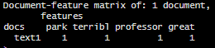
Review of Practices – NLP basics
"The parking at IU is terrible, but the professors are great! ☺"
Tokenize: "The“ "parking“ "at“ "IU" "is“ "terrible“ "but“ "the“ "professors“ "are“ "great“
Remove stopwords: "The“ "parking“ "at“ "IU" "is“ "terrible“ "but“ "the“ "professors“ "are“ "great“
Stem: “parking” “terrible” “professors” “great”
Restructure to document-feature matrix:
Model!

Slide 14
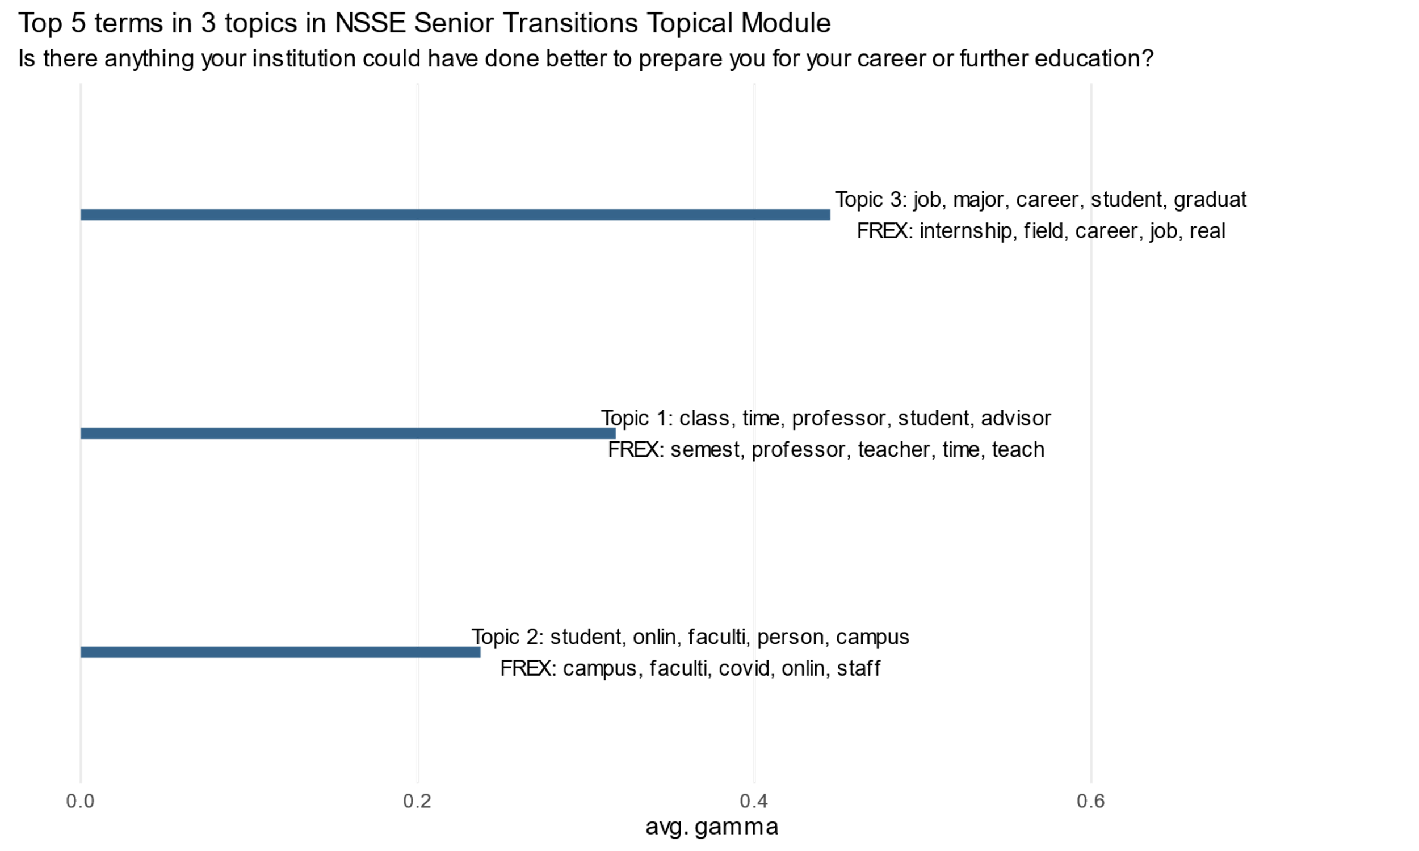
Notes:
First we look at (average) gamma, or the share of documents associated with each topic. There will be K, and the topic number is arbitrary. Up to you to decide how to label it and if it makes sense (semantic coherence).

Slide 15
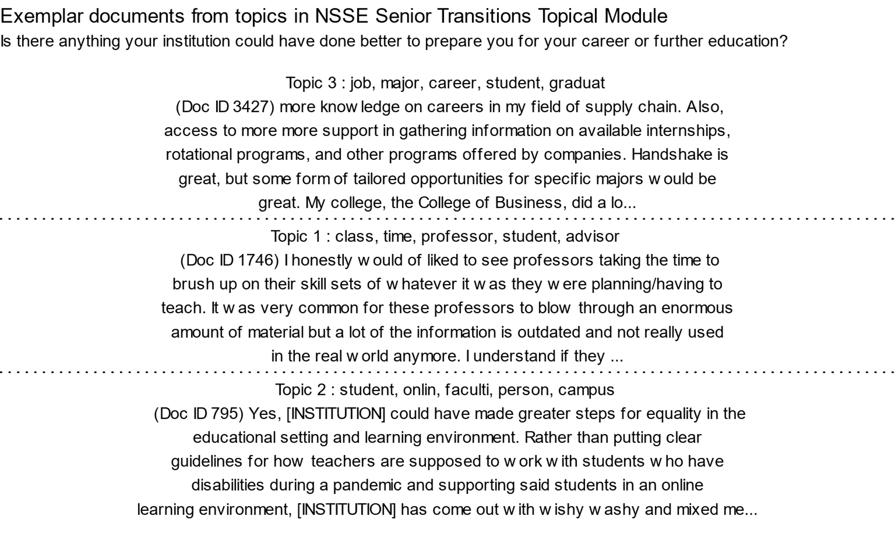
Notes:
Examplar documents are high-gamma documents. Ie these students mostly talked about topic K.

Slide 16
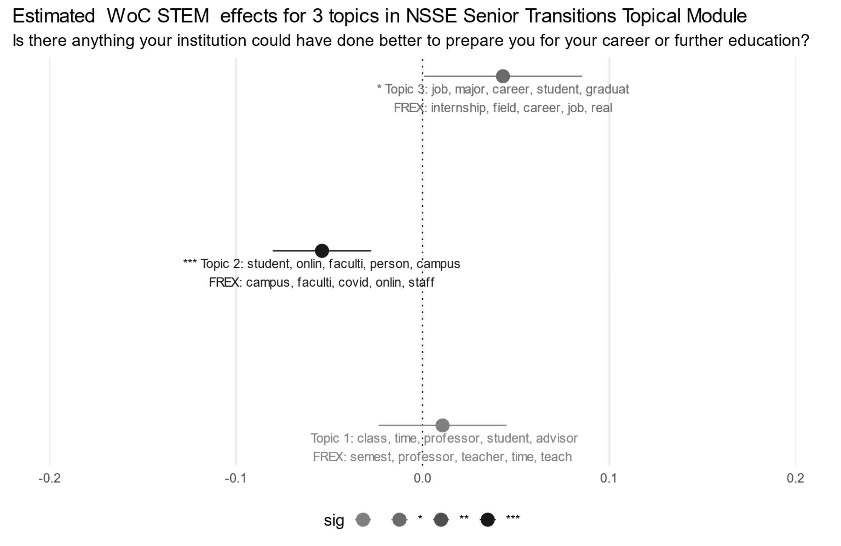
Notes:
Topical prevalence differences between groups. With STM, also can assess effect of author metadata with estimateEffect(). Standard regression outputs.

Slide 17
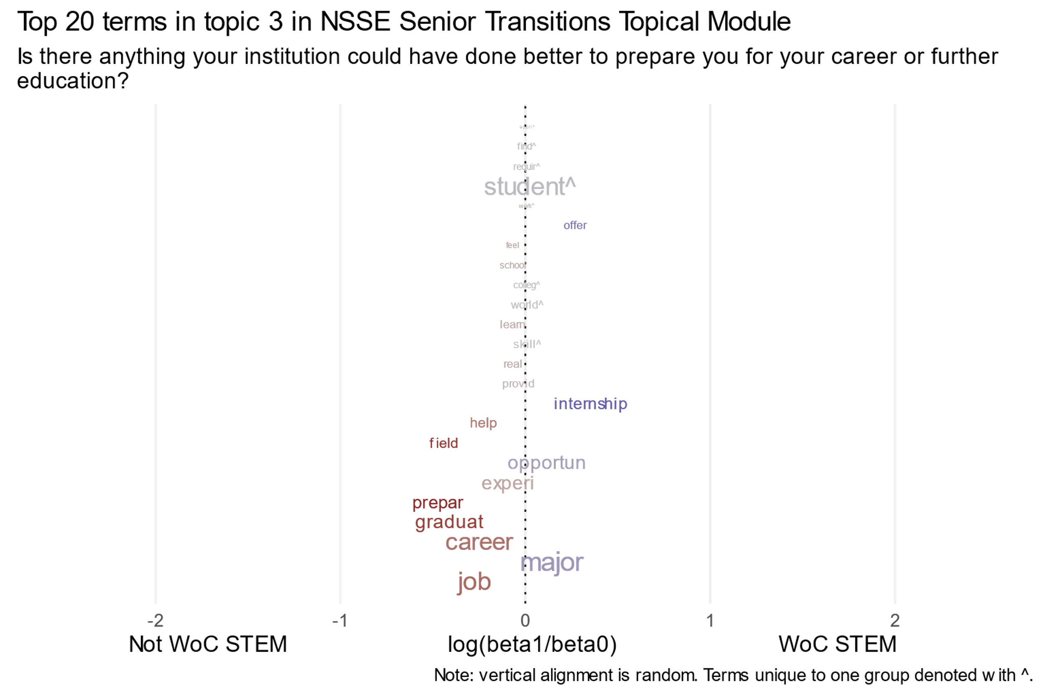
Notes:
Topical content differences between groups. Do students describe the topics differently? The log ratio is plotted: where x=1, probability is x2 relative to not woc stem, and ½ where –1.

Slide 18
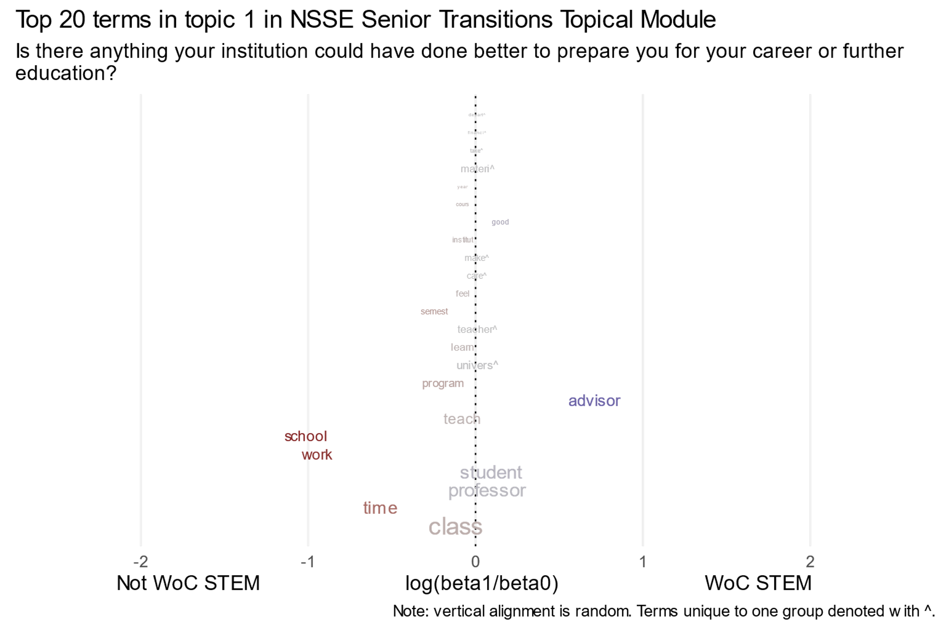

Slide 19
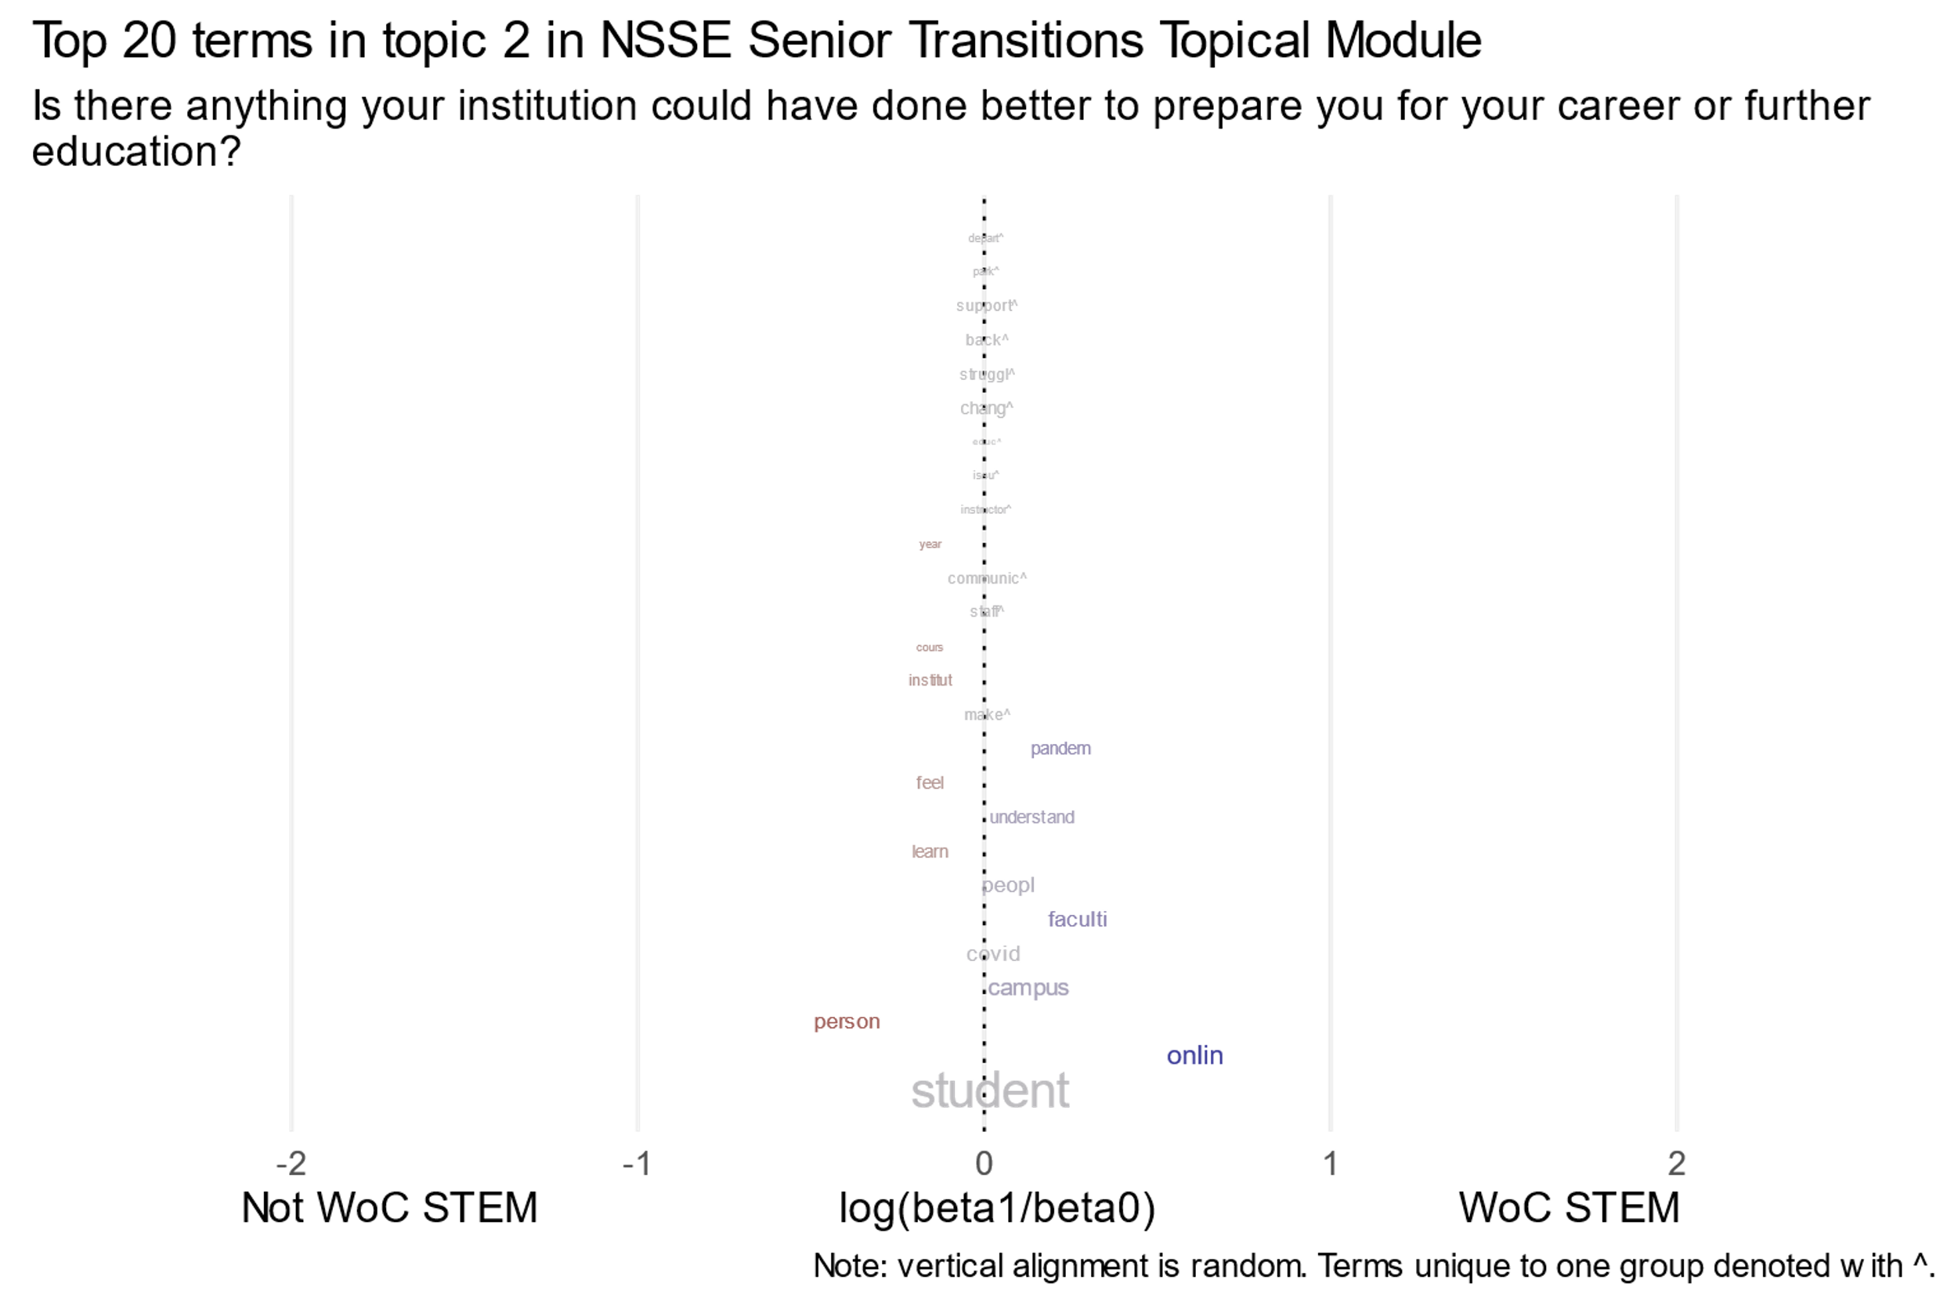

Slide 20
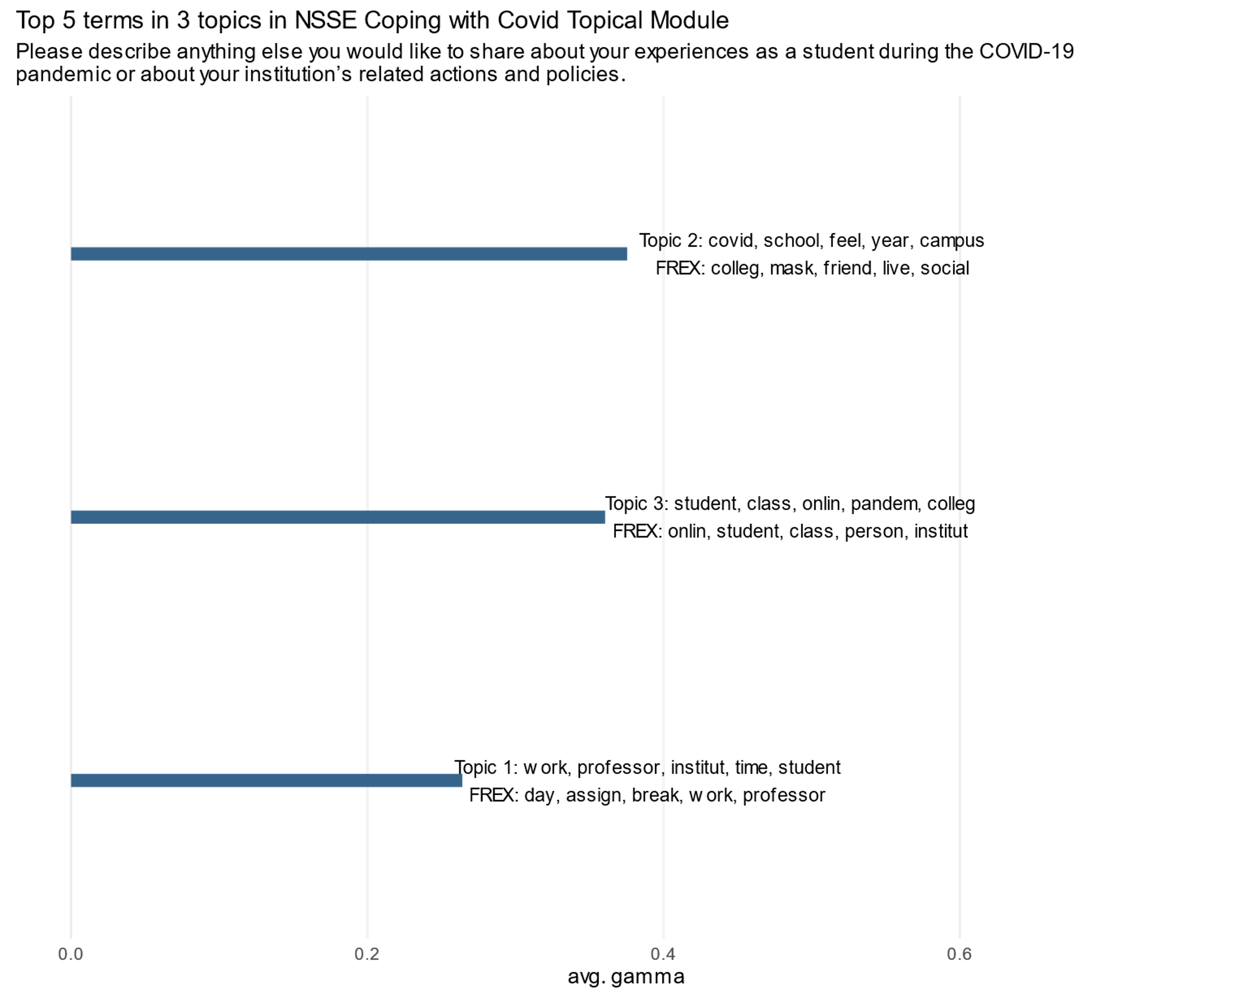
Notes:
Proposed labels: 2. social aspects, 3. online/course modality, 1. professors & coursework

Slide 21
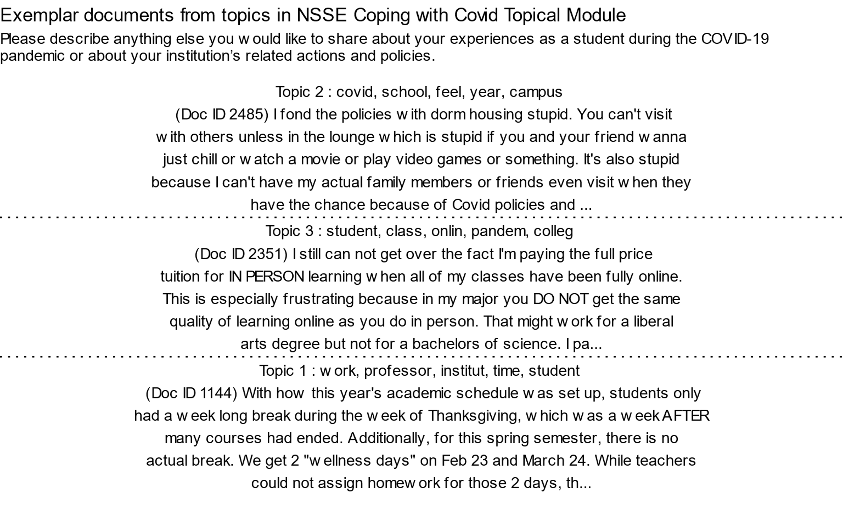

Slide 22
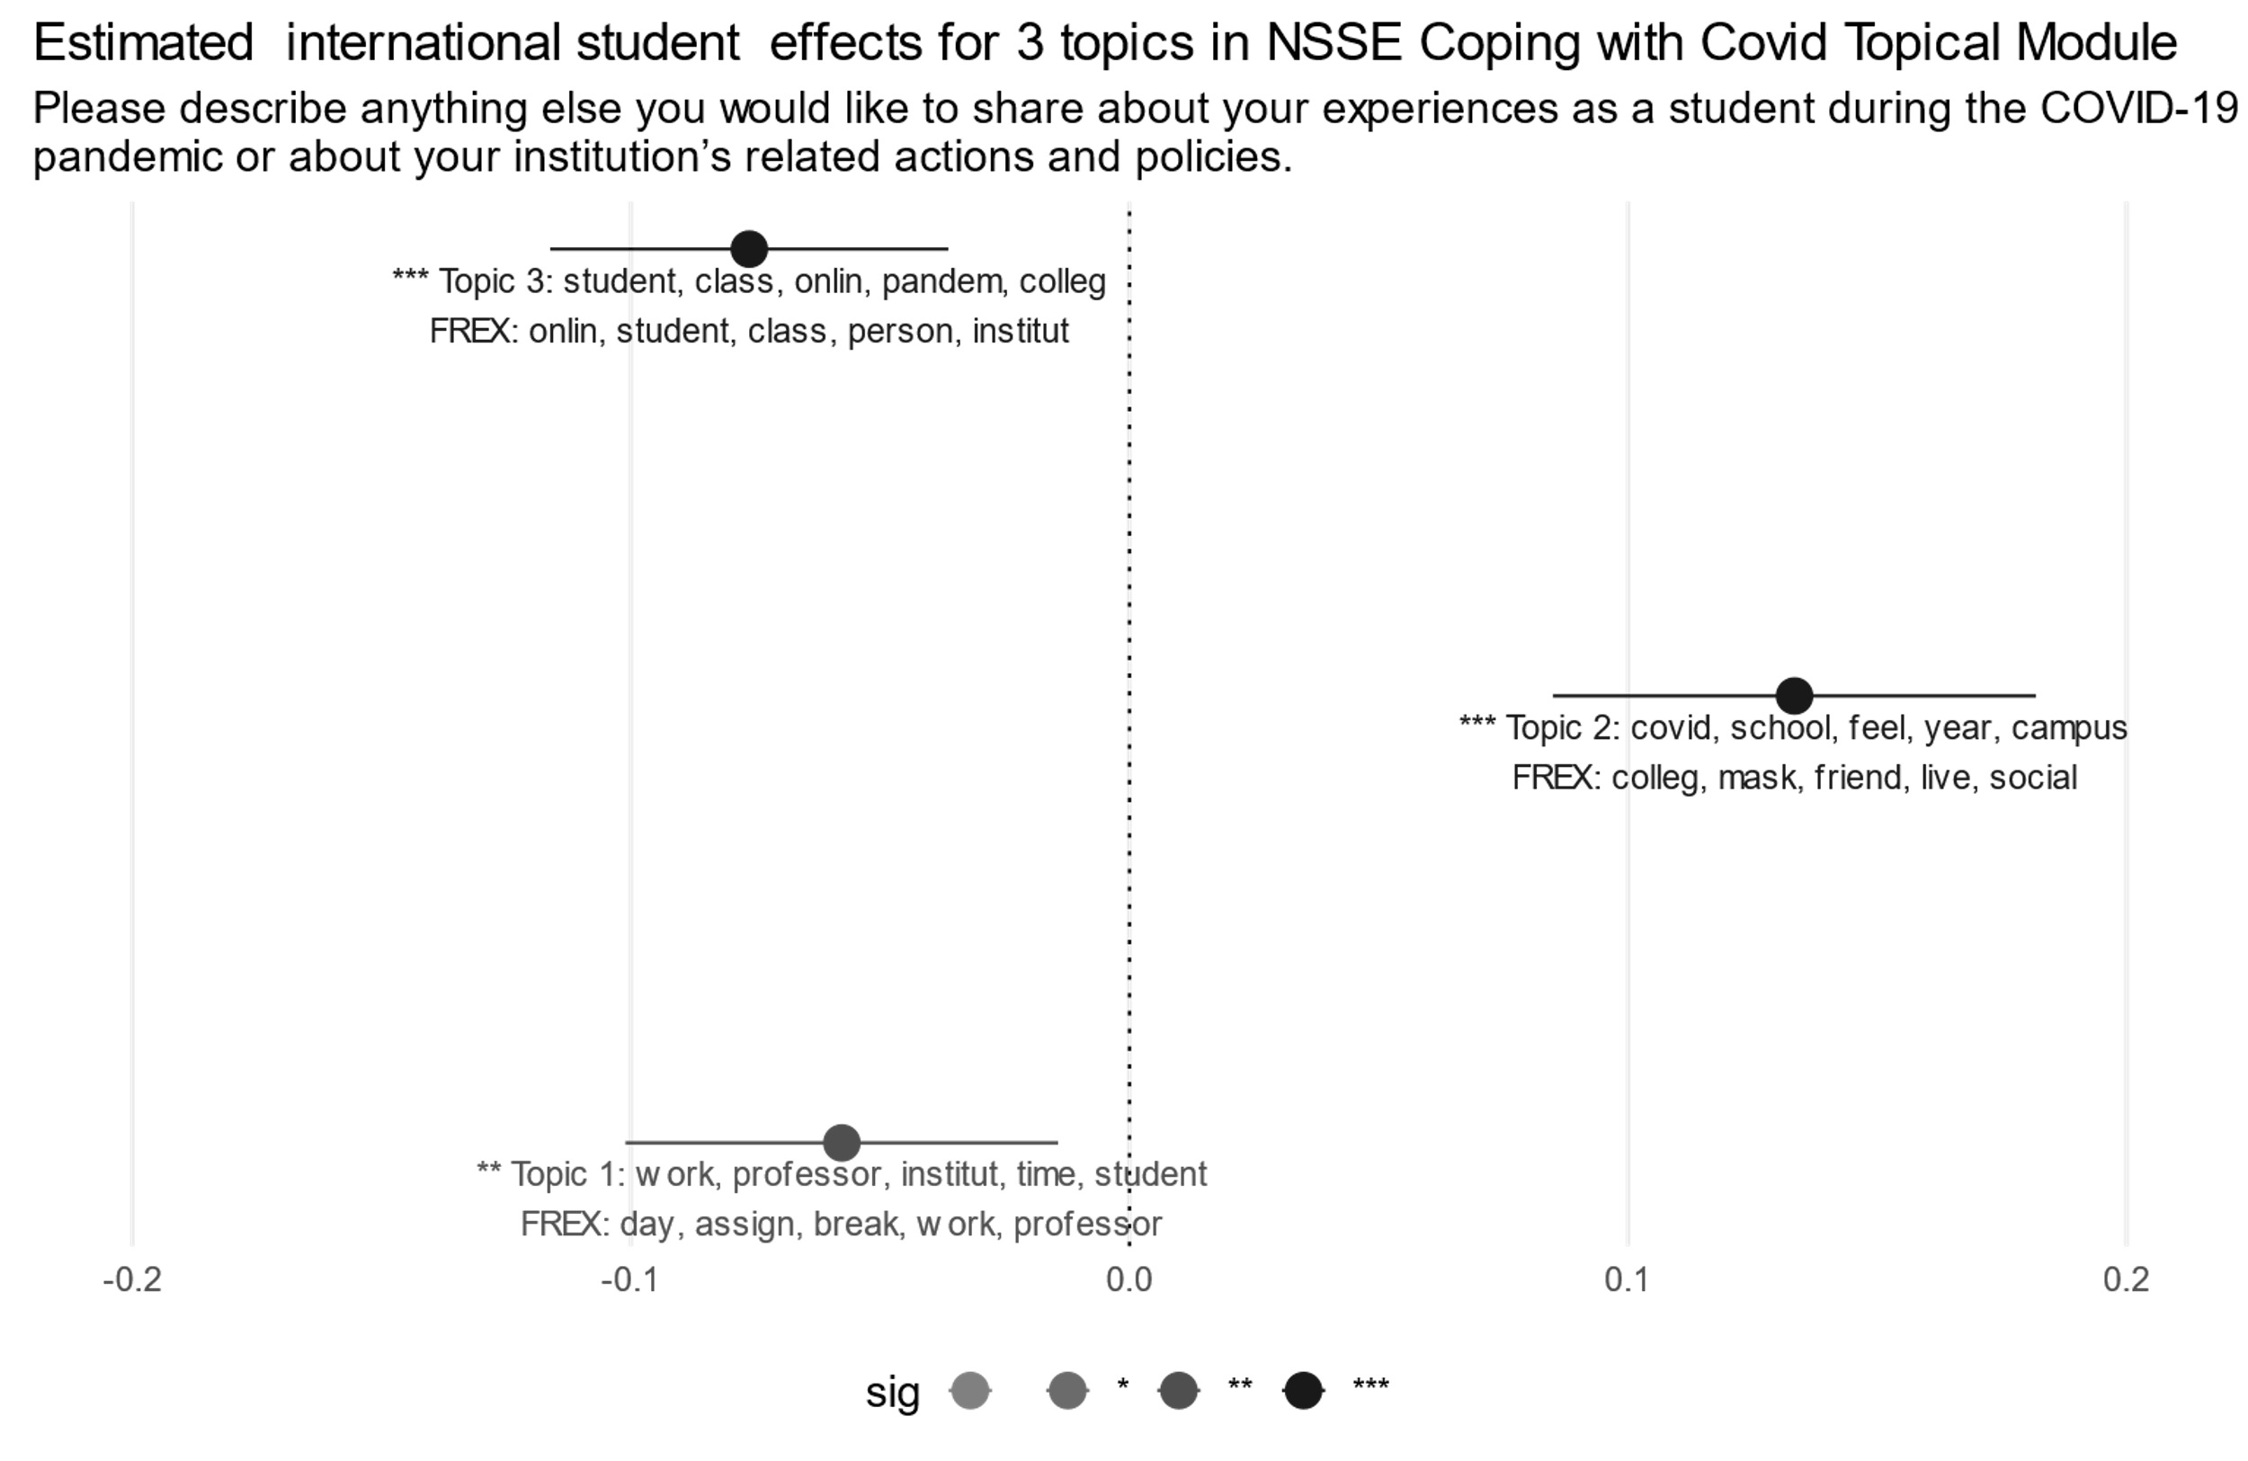

Slide 23
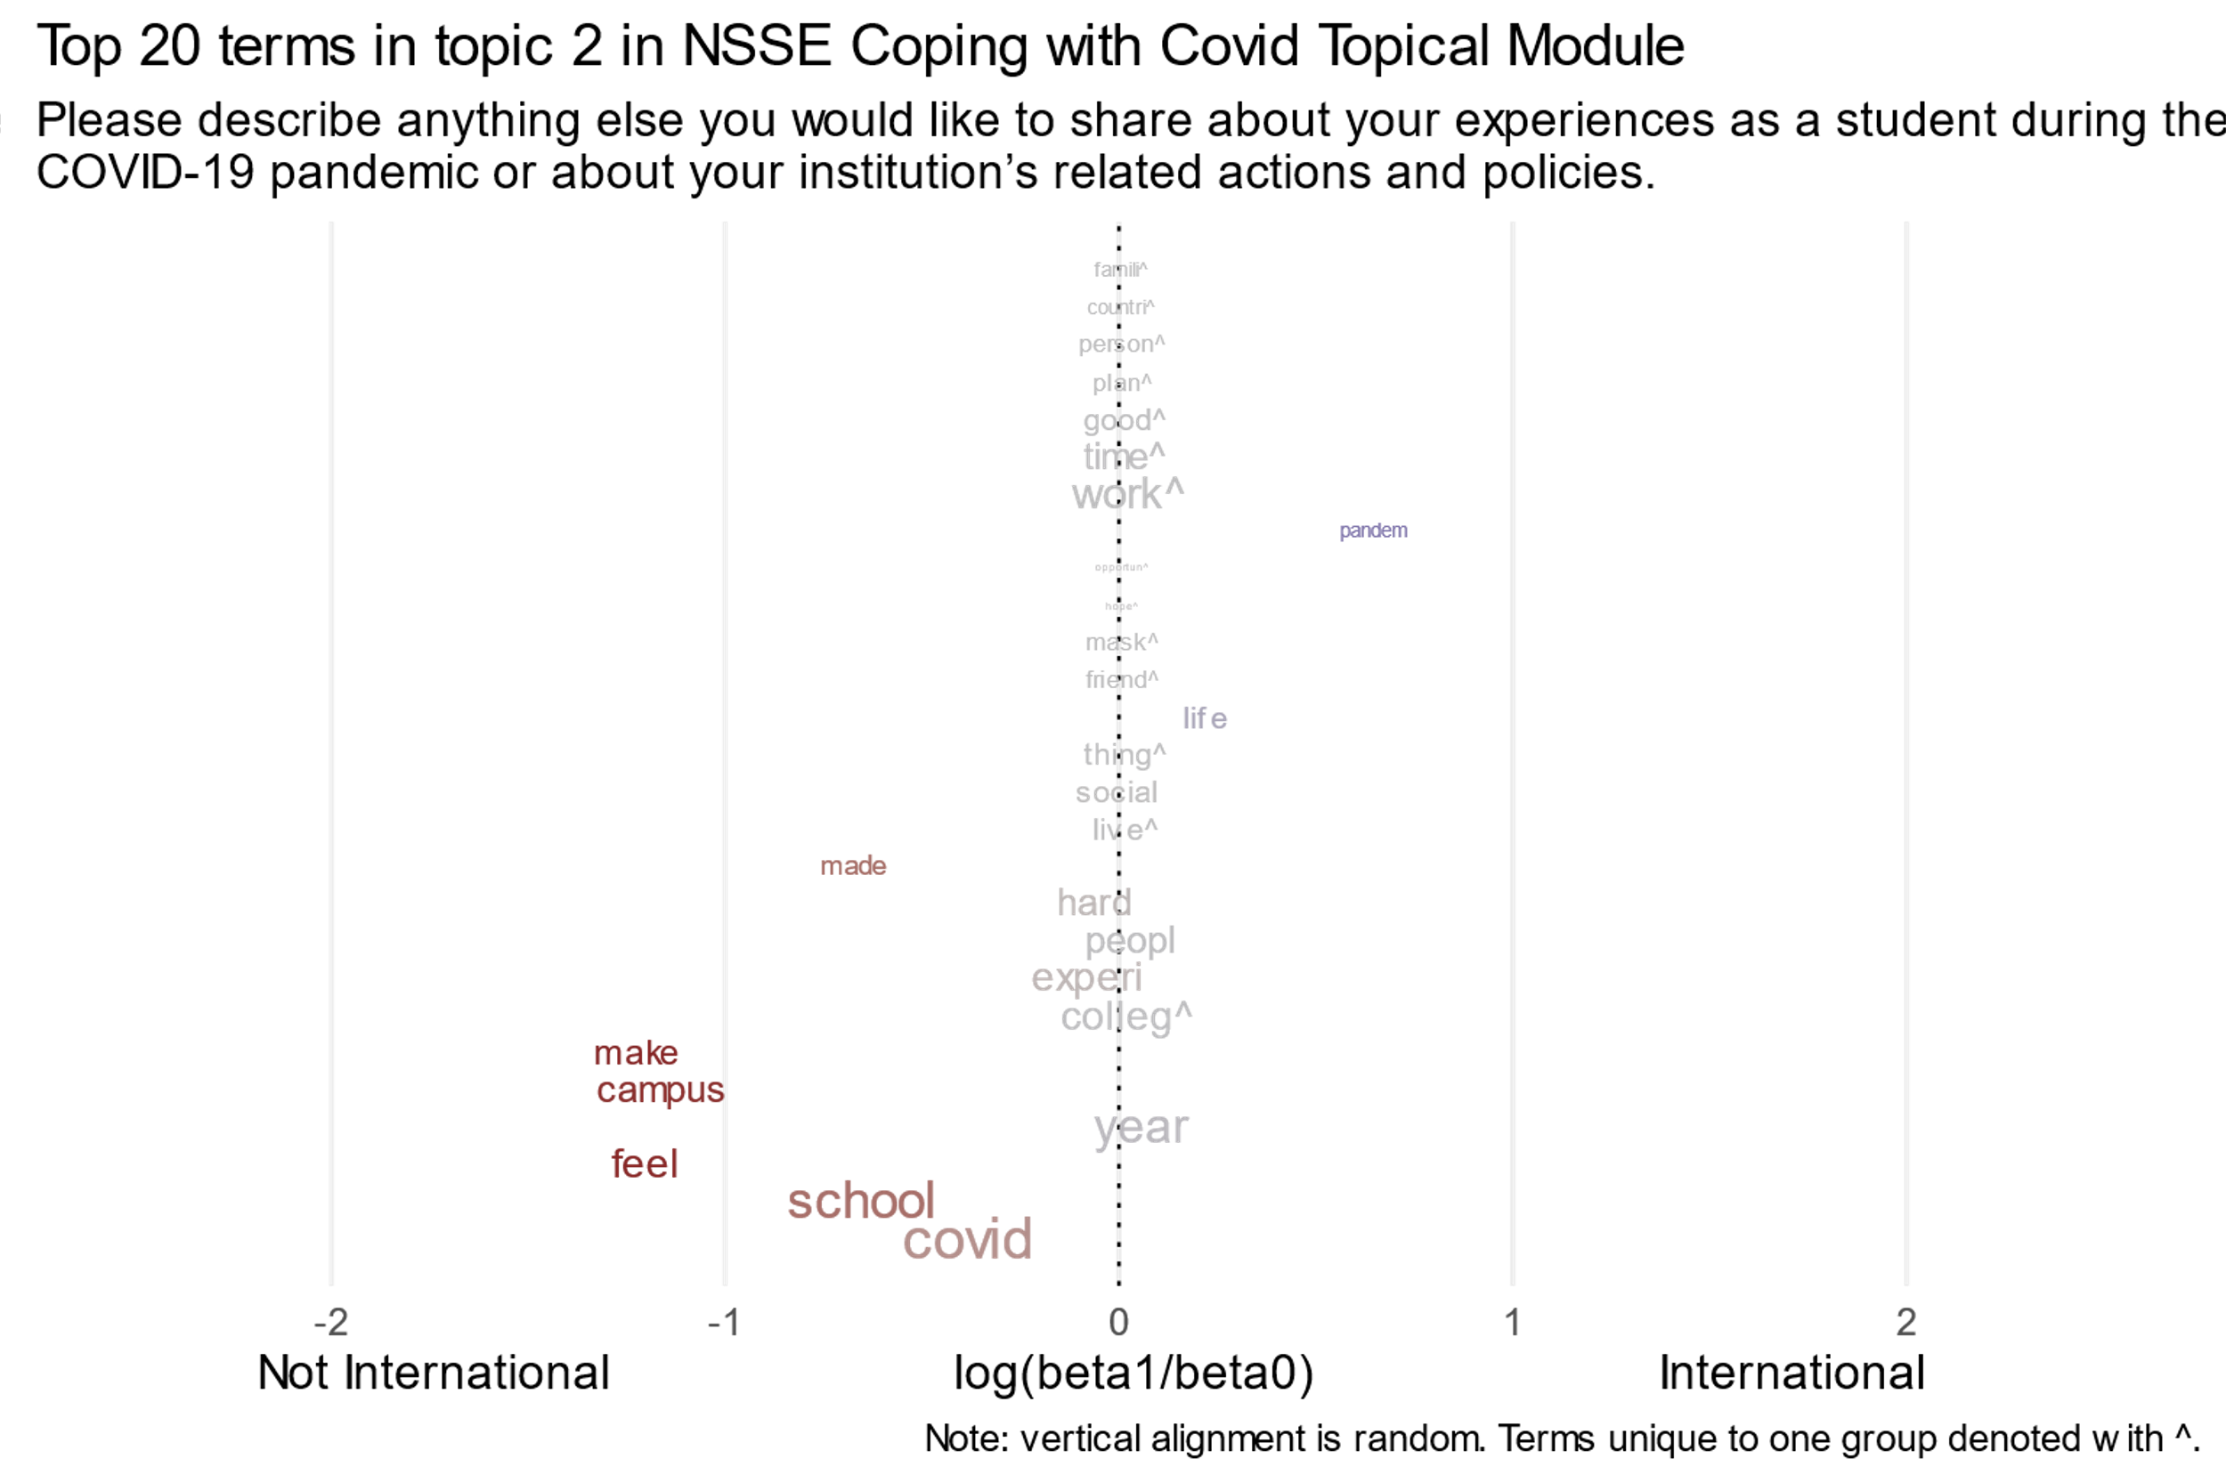

Slide 24
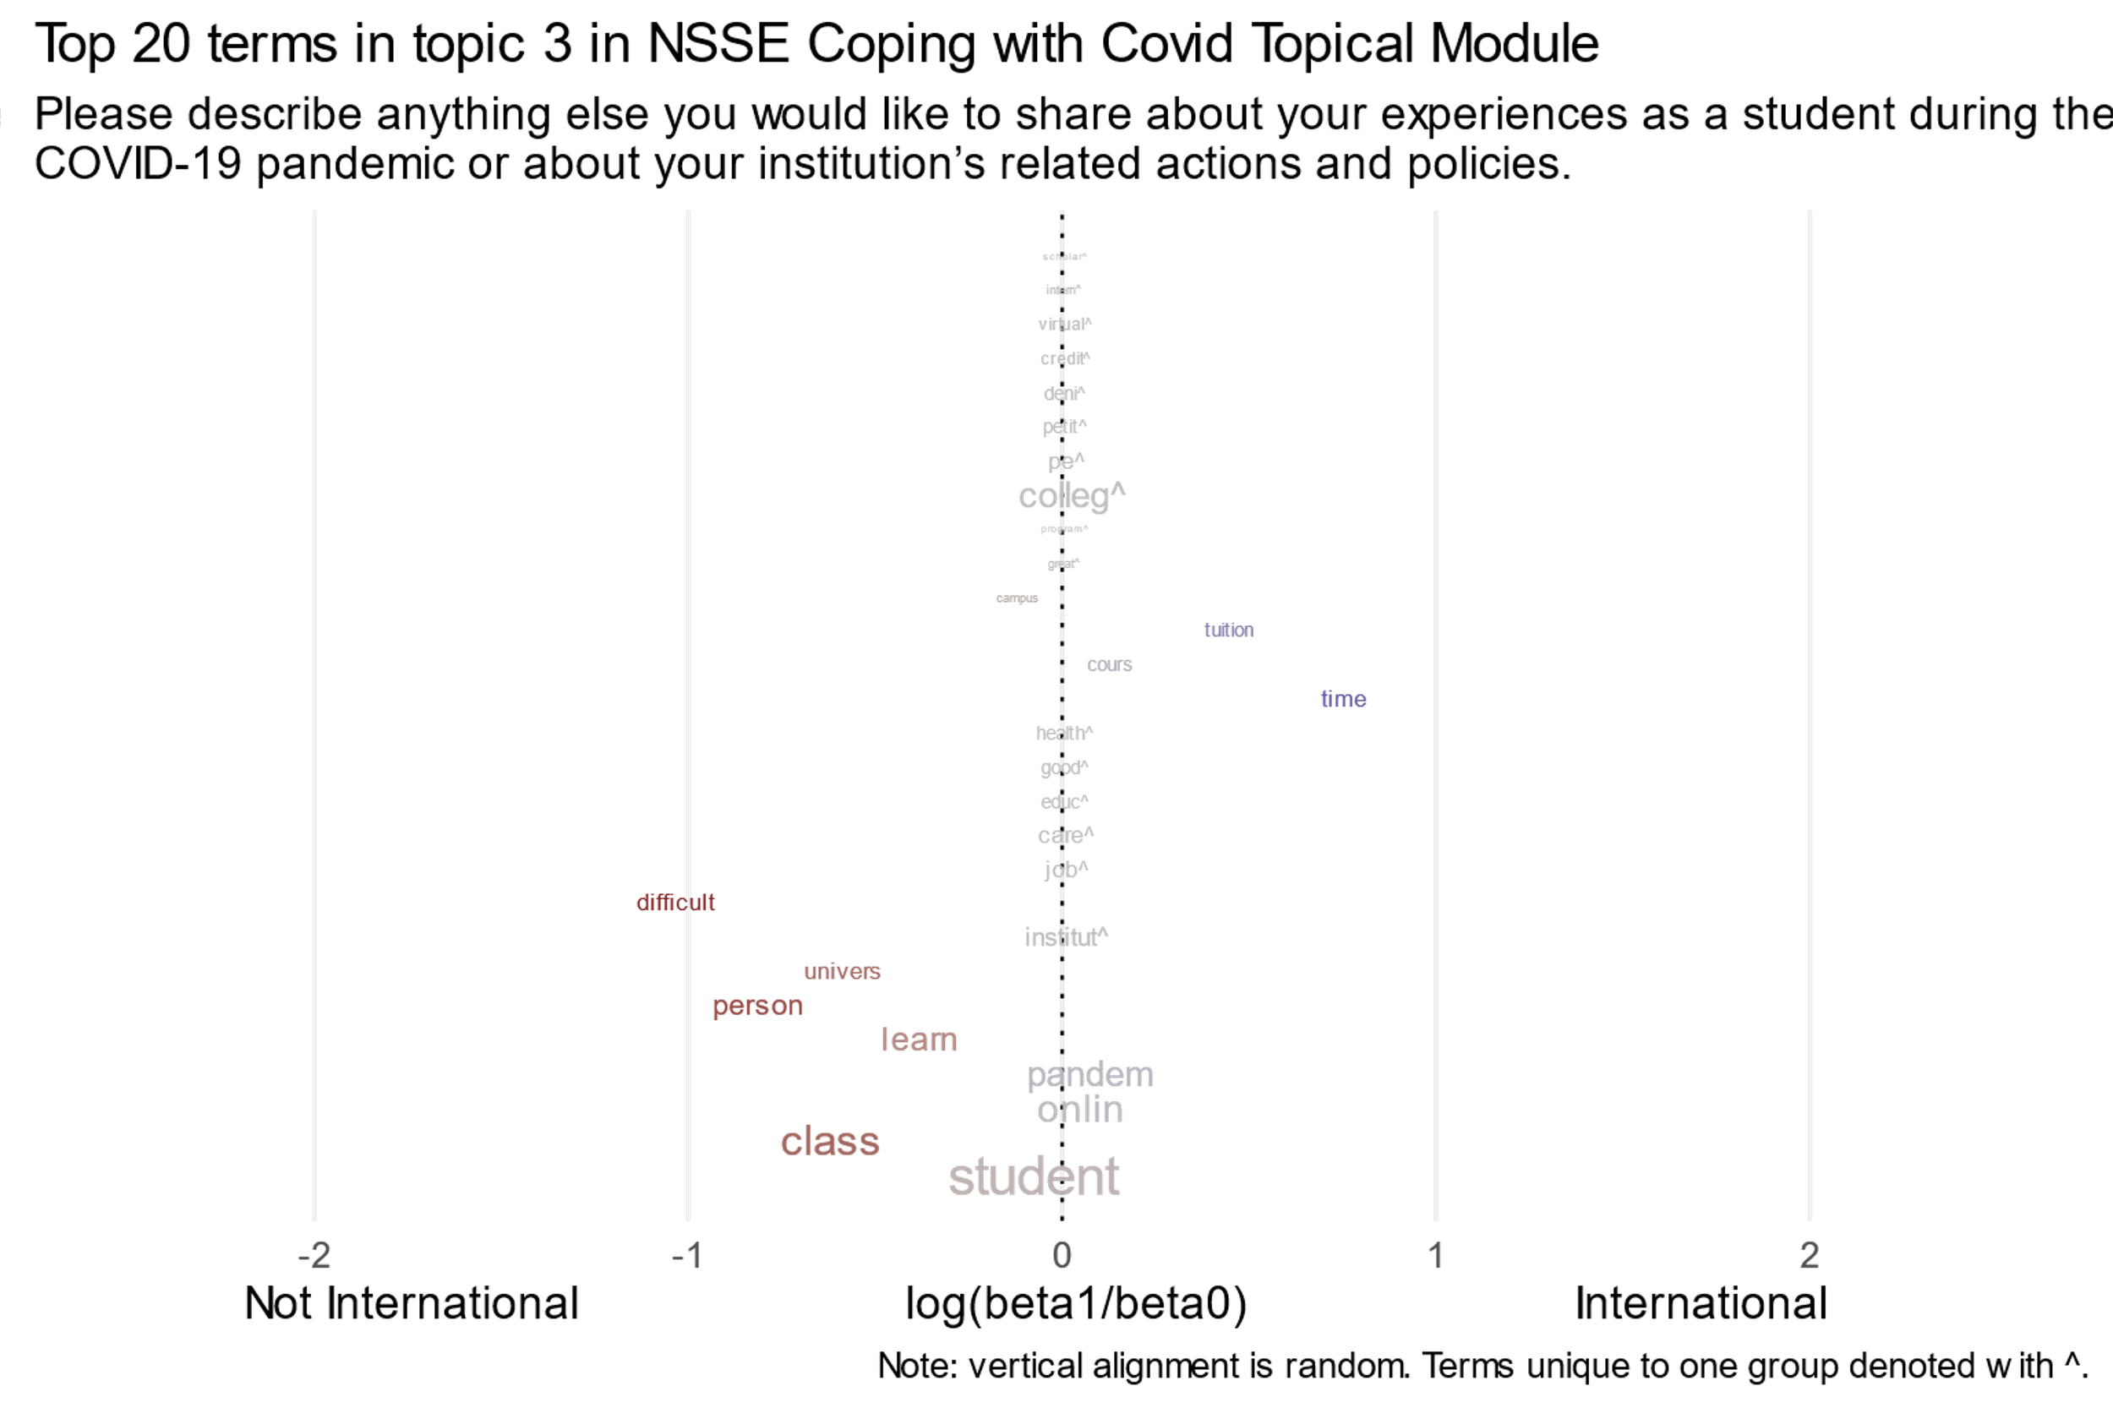

Slide 25
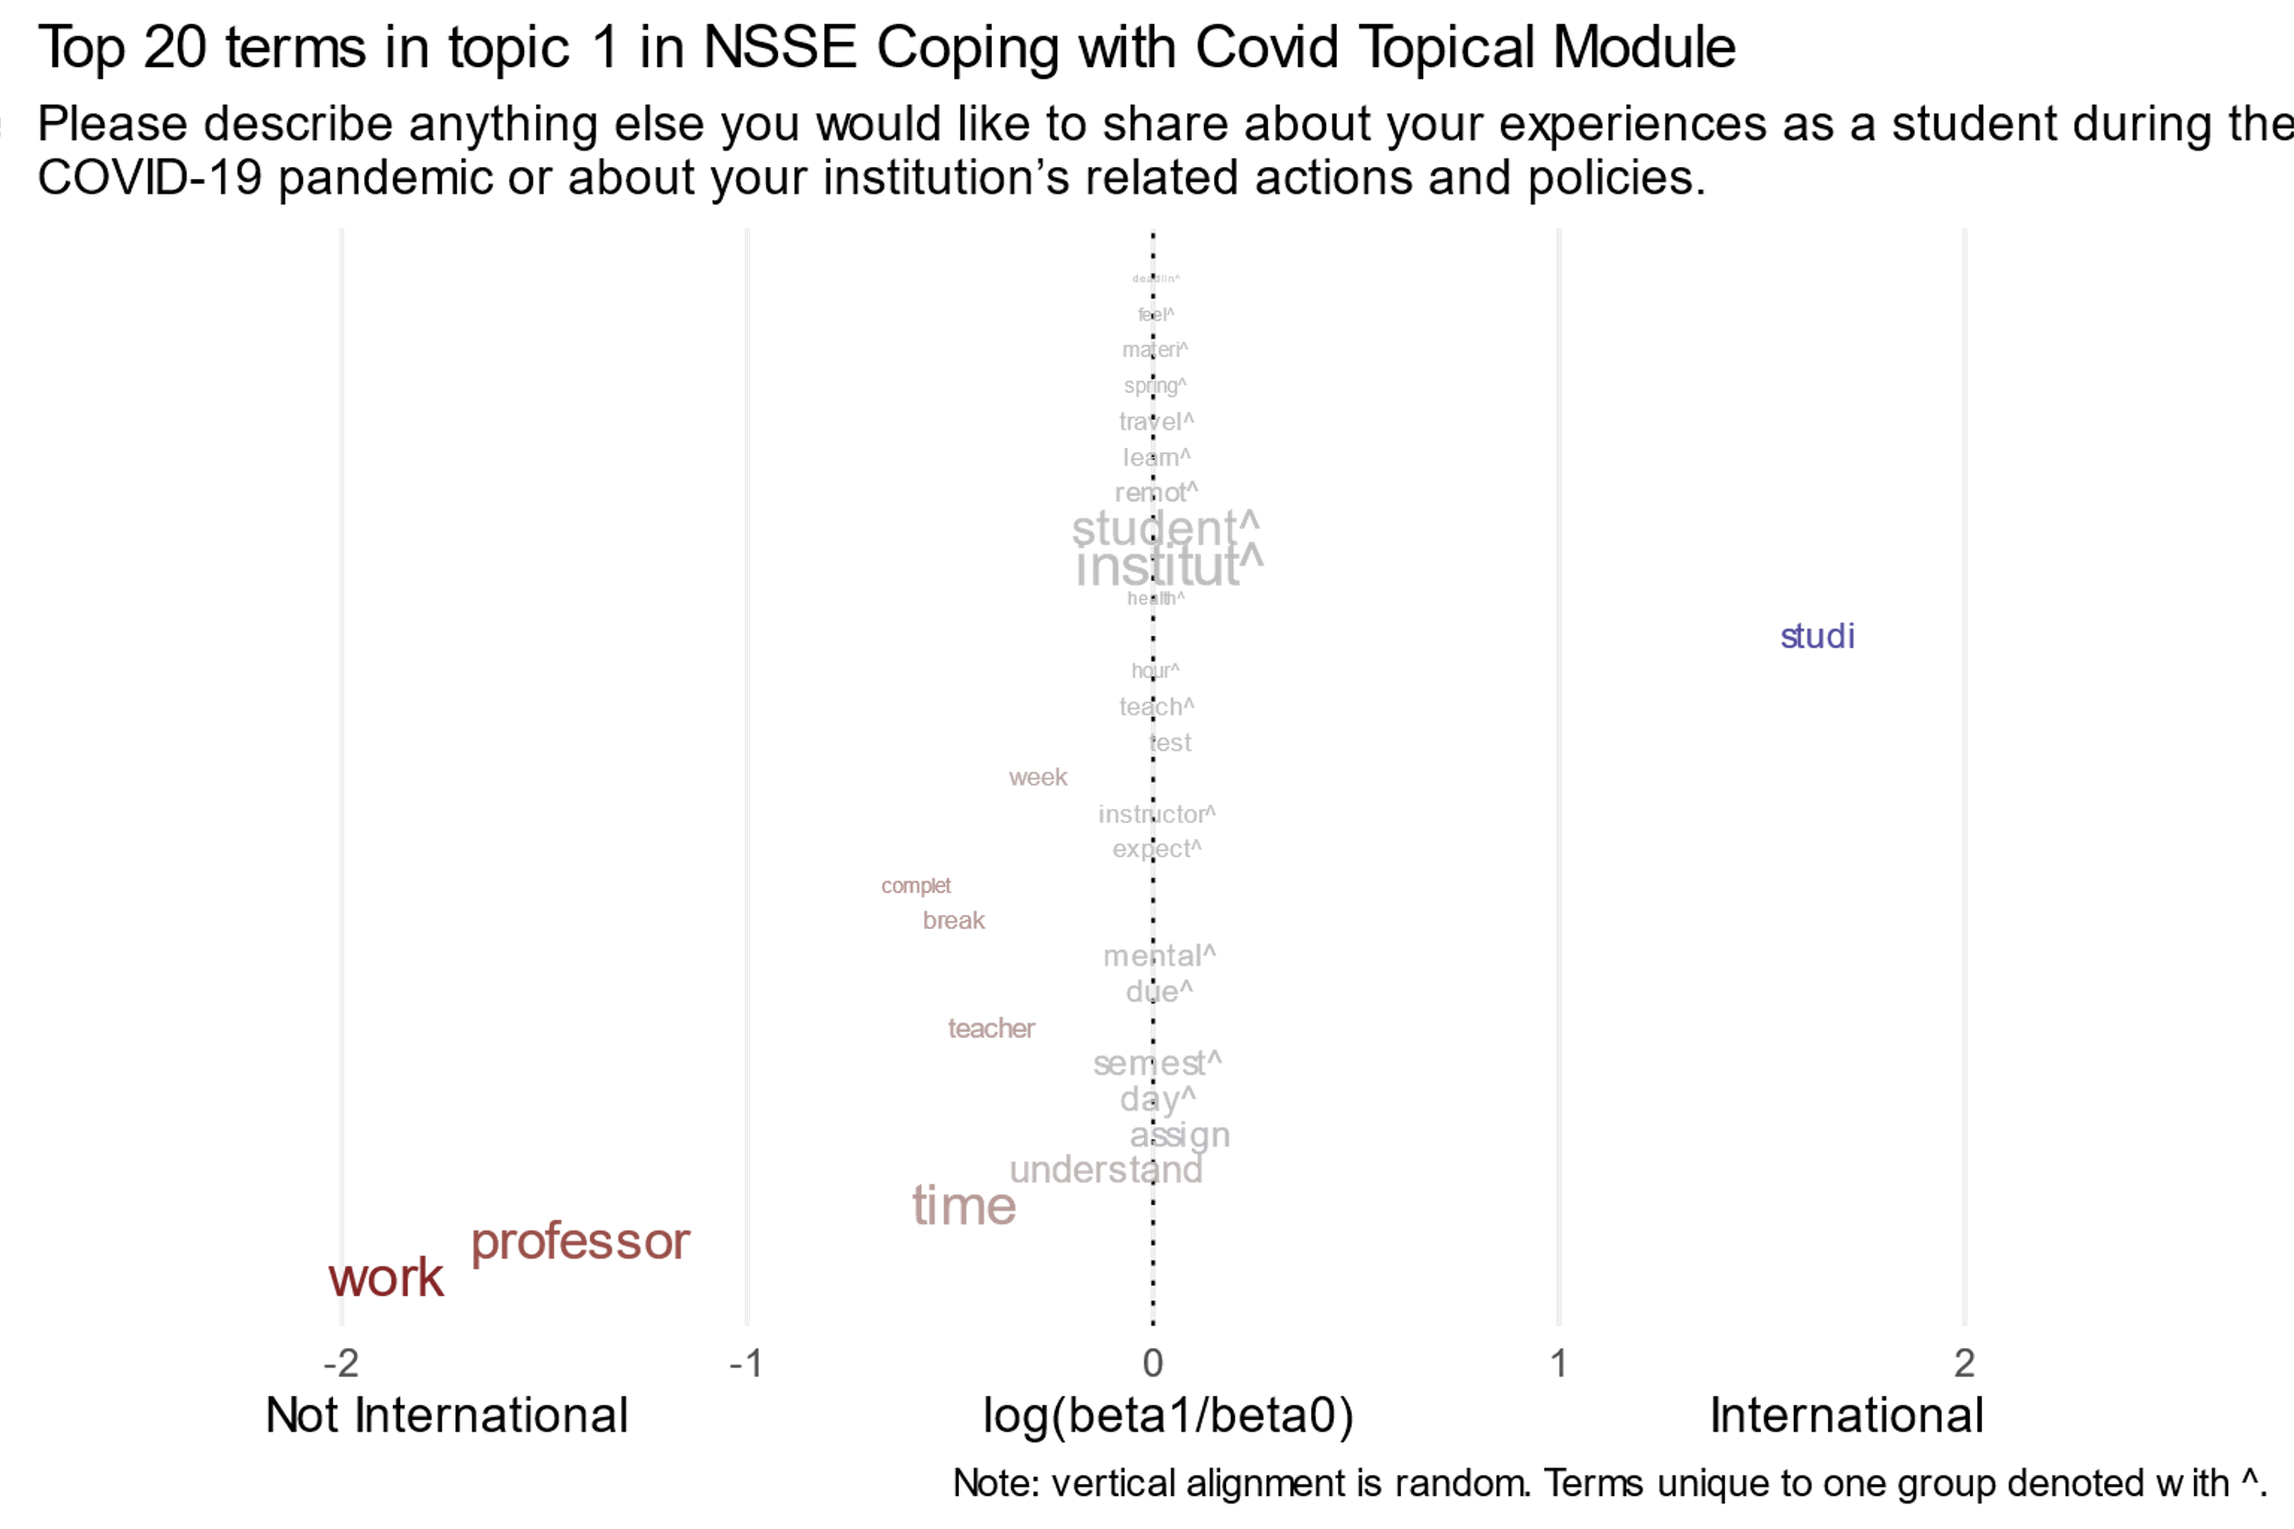

Slide 26
Conclusions

Slide 27
Case 1: Senior Transition - Post-Graduation Plan 3 Key Topics from NLP Text Data analyses
CONCLUSIONS
Topic 3** (+): Match Curriculum with Industry Standards and Expectations
Industry Alignment and Career-Specific Preparation and Opportunities,
Curricular Adaptation for Skills Development,
Enhancing Competitiveness and Marketability.
Topic 1: Inclusive and Modern Education for Diverse Student Populations
Holistic Support for Non-Traditional Students (e.g. advising)
Possible disparities among Different Type of Students.
Topic 2*** (-): Real-World Readiness through Practical, Interactive Teaching and Learning
Aligning course content with real-world demands: practical skill development in courses, industry-relevant coursework,
Expecting more interactive and dynamic learning environments.

Slide 29
Case 1: Senior Transition - Post-Graduation Plan
Major Terms for WoC STEM vs. Other Students
 | Topic 3* | Topic 1 | Topic 2***
WoC STEM | Appli, find, requir, student | Depart, financi, advisor, take, materi | Depart, park, support, struggl, chang
Other Students | Work, colleg, world, skill | Student, professor, class, teach, program, | Educ, instructor, staff, communic
Both | Feel, school, internship, provi, | Make, care, teacher, univer, school, work | Student, onlin, campus, cours, understan, feel

Slide 30
Case 2: Coping with COVID – Institutional Response Feedback
CONCLUSIONS
3 significant topics identified from NLP Text Data analyses
Topic 2*** (+) : Social challenges imposed by policies
Lack of understanding on the differences between interacting in public spaces vs. in private spaces
Frustration with lack of individualized social outlets
Strict policies even for family members
Topic 3*** (-) : Frustration with the modality of online classes
Feeling unfair the education they paid for
Feeling unsatisfied with the quality of education received online
Pointing out disciplinary differences on the need for in-person classes with science majors
Topic 1** (-) : Learning fatique due to break polices
One week-long break between semesters is not enough
Getting two "Wellness Days" with no assignments instead of a full spring break is not enough
Faculty intentions for course learning conflicting with institutional intentions on breaks

Slide 32
Case 2: Coping with COVID – Institutional Response Feedback
Major Terms for International vs. Domestic Students
 | Topic 2*** | Topic 3*** | Topic 1**
International | work, time, good, plan, person, countri, famili | colleg, petit, deni, credit, virtual | institut, student, studi, remot, learn, travel, spring, materi
Domestic | feel, campus, make, colleg, live, thing, friend, mask | class, learn, person, univers, institut, difficult, job, care, educ, good, health | work, professor, time, day, semest, due, mental, expect, instructor, teach, hour
Both | year, peopl, hard, made, social, life, pandem | student, online, pandem, time, cours, tuition, campus | assign, teacher, break, complet, week, test
Notes:
Proposed labels: 2. social aspects, 3. online/course modality, 1. professors & coursework

Slide 33
Overall Conclusions and Implications
The NLP technique is efficient for generating topics qualified by frequent and exclusive key terms to offer insights such as:
Students appreciate curricula matched with industry standards and expectations
Social challenges imposed by institutional policies were a major source of complaints
The topics and key terms frequently used by different student populations can be visualized and reveal, for example:
International students may be less interested in the modality of instruction while domestic students may be more concerned with mental health and expectations such as due dates
Common interests or polarity of topics among different student groups can also be spotted
Still requires your input!
Notes:
Proposed labels FYS: 3. Internships and careers, 1. advisor and faculty relationships, 2. course support (pos. Covid-related)
Proposed labels COV: 2. social aspects, 3. online/course modality, 1. professors & coursework
This is a point of departure for further analysis.
This is not necessarily representative (who is motivated to leave a comment?)

Slide 34
Demonstration and Steps to Create Your Own

Slide 35
Corpus-Tokenize-Stopwords-Stem-DFM-STM
library(quanteda) (x <- "The parking at IU is terrible, but the professors are great! :)")
[1] "The parking at IU is terrible, but the professors are great! :)"
(x <- tokens(x, what = "word", remove_punct = TRUE))
Tokens consisting of 1 document.
[1] "The" "parking" "at" "IU" "is" "terrible" "but" "the" "professors" "are" "great"
(x <- tokens_remove(x, c(stopwords("english", source = "smart"), "IU") ) )
Tokens consisting of 1 document. [1] "parking" "terrible" "professors" "great"
(x <- tokens_wordstem(x))
Tokens consisting of 1 document. [1] "park" "terribl" "professor" "great"
dfm(x)
Document-feature matrix of: 1 document, 4 features (0.00% sparse) and 0 docvars. features docs park terribl professor great text1 1 1 1 1

Slide 36
Corpus-Tokenize-Stopwords-Stem-DFM-STM
library(dplyr)
library(quanteda) library(stm) # quanteda functions to create and clean document-feature matrix my_dfm <- read.csv("my_data.csv") |> # base pipe %>% select(id, metadata, text) |> mutate(text = tolower(text)) |> corpus(docid_field = "id", text_field = "text", meta = list(metadata))

Slide 37
Corpus-Tokenize-Stopwords-Stem-DFM-STM
my_dfm <- tokens( my_dfm,
what = "word", remove_punct = TRUE, remove_numbers = TRUE, remove_separators = TRUE, split_hyphens = TRUE, include_docvars = TRUE) |> tokens_remove( c(stopwords(language = "english", source = "smart"), "IU", "IUB", "other", "custom", "stopwords")) |>
tokens_wordstem() |> dfm()

Slide 38
Corpus-Tokenize-Stopwords-Stem-DFM-STM
library(tibble)
convert(my_dfm, "data.frame") |> as_tibble() |> head()
# A tibble: 6 × 4,472 doc_id general professor understand work student affect <chr> <dbl> <dbl> <dbl> <dbl> <dbl> <dbl> 1 70002… 1 1 1 1 1 1 2 70003… 0 0 1 0 0 0 3 70004… 0 0 0 0 0 0 4 70004… 0 0 0 0 0 0 # ℹ 4,462 more variables: pandem <dbl>, applaud <dbl>, …

Slide 39
Tokenize-Corpus-Stopwords-Stem-DFM-STM
library(stm)
library(broom)
library(tidytext)
my_stm <- stm(my_dfm, K = 3, prevalence = ~metadata,
content = ~metadata, # doing both can take time! init.type = "spectral")
my_stm
## A topic model with 3 topics, 3018 documents and a 4471 word dictionary
glance(my_stm)
k docs terms iter alpha <int> <int> <int> <int> <dbl> 1 3 3018 4471 85 16.7

Slide 40
Tokenize-Corpus-Stopwords-Stem-DFM-STM
tidy(my_stm, matrix = "gamma") |> arrange(document) |> head()
# A tibble: 6 × 3 document topic gamma <int> <int> <dbl>
1 1 1 0.392 2 1 2 0.182 3 1 3 0.426 4 2 1 0.233 5 2 2 0.538 6 2 3 0.229
tidy(my_stm, matrix = "beta") |> arrange(desc(beta)) |> head()
# A tibble: 6 × 4 topic term beta y.level <int> <chr> <dbl> <chr> 1 3 student 0.0729 FALSE 2 3 student 0.0690 TRUE 3 1 work 0.0502 FALSE 4 3 class 0.0438 FALSE 5 1 professor 0.0404 FALSE 6 2 covid 0.0394 FALSE

Slide 41

Creating your own
Roberts et. al. 2019 “stm: R package for Structural Topic Models” (https://www.jstatsoft.org/article/view/v091i02)
Roberts et. al. 2014. "Structural Topic Models for Open-Ended Survey Responses" (https://onlinelibrary.wiley.com/doi/full/10.1111/ajps.12103)
Text Mining with R (https://www.tidytextmining.com/) (LDA)
R packages:
Cleaning and extracting model summaries: dplyr, broom, tidyr (tidyverse)
Tokenizing and text cleaning: quanteda, stringr
Modeling: stm, topicmodels (LDA), quanteda (QUANtitative analysis of TExtual DAta)
Plotting: ggplot2, stm
Other useful packages: tidytext, rmarkdown, tokenizers

Slide 42

Q & A

